Slide 1
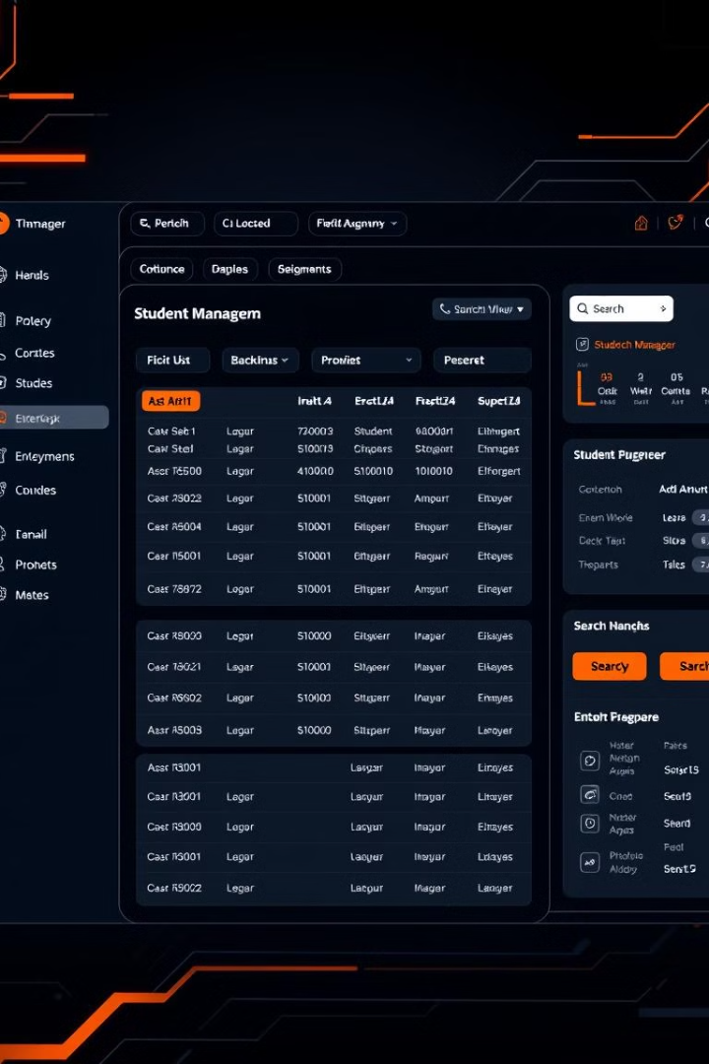

Student Record Management System
CHANDAN CHOUDHURY | CL2025010601911046 | 2201020352
ADITYA NAYAK | CL2025010601911349 | 2201020377
SANJEEB KUMAR POTHAL | CL2025010601938185 | 2201020411
GYANA RANJAN SAHOO | CL2025010601938118 | 2201020033

Slide 2
INTRODUCTION
The Student Management System is a console-based application. It is designed in C for efficient student record management. Key features include adding, modifying, deleting, and searching student details. The system utilizes doubly linked lists and file handling.
From Chaos to Clarity: Solving the Data Management
The Challenge
Our Solution
Traditional methods of student record management can be inefficient. Spreadsheets are often error-prone.
The SMS provides a structured and user-friendly way to manage student data. It eliminates redundancy. It also improves data accuracy.

Slide 3

The Power of CRUD: Core Operations Unveiled
1
Create
Add new student records with details. Include name, ID, major, and GPA. The system has input validation to ensure data integrity.
2
Read
Search for student records by ID or name. Student details are displayed in a clear format.
3
Update
Modify existing student records. This allows changes to details while maintaining consistency.
4
Delete
Remove student records from the system. Safeguards prevent
accidental data loss.

Slide 4
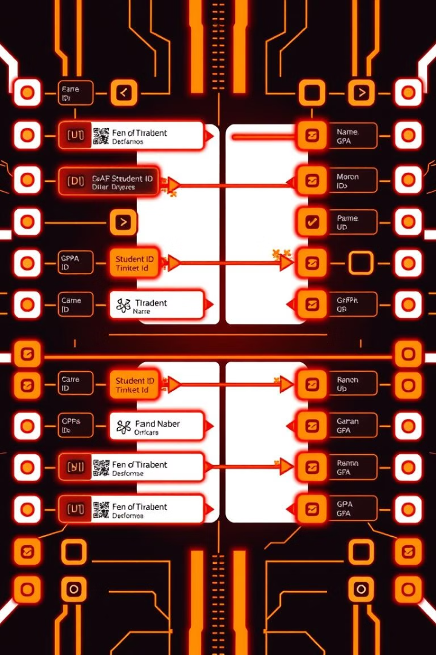




Doubly Linked Lists: The Backbone of Dynamic Data
Dynamic Memory
Efficient Insertion
Efficient Deletion
Dynamic Resizing
Doubly Linked Lists provide dynamic memory allocation. This allows efficient insertion and deletion. Traversal is easy in both directions. It avoids fixed-size array limitations.

Slide 5




File Handling: Ensuring Data Persistence
Implementation
Purpose
1
2
Use C file I/O to read/write records. Binary file format is used.
Store student data on disk persistently.
File Operations
Error Handling
Opening, reading, writing, and closing the student data file.
Checks handle file-related errors.
4
3

Slide 6
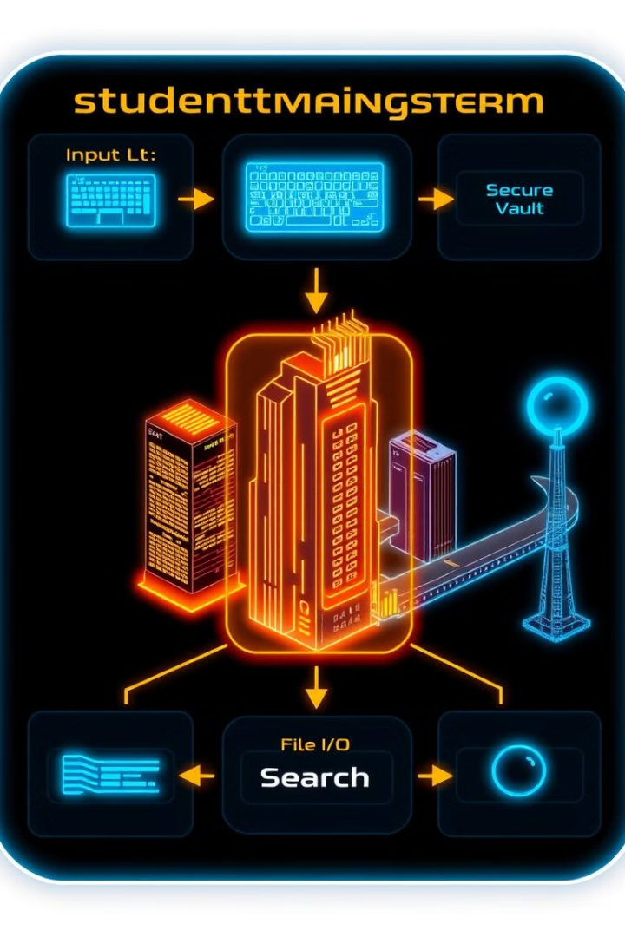




System Architecture: Modules in Harmony
Input Module
Handles user input and validation.
Data Management Module
Implements CRUD operations.
File I/O Module
Manages persistent storage.
Search Module
Enables efficient searching.

Slide 7
SMS vs. The World: A Comparative Analysis
1
Manual Record-Keeping
2
Automated Systems
3
Database Systems
Traditional systems involve paper-based records. Our system uses digital records. Searching is manual, while ours offers instant search. Data loss is a risk, while ours offers permanent storage.

Slide 8
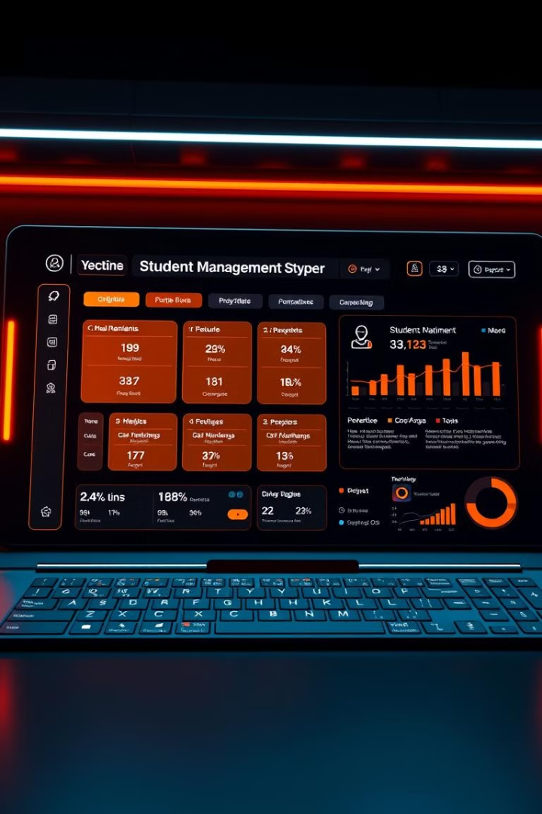
Looking Ahead: Addressing Challenges and Enhancing the System
1
2
GUI
Database
Implement a GUI-based version.
Migrate to a database system.
3
Authentication
Add user authentication and control.

Slide 9

CONCLUSION
The Student Management System offers efficiency in managing student data. This project shows the importance of efficient student management.
Learning Outcomes from this project :-
Data Structure | Purpose
Doubly Linked List | Store and manage student records
File Handling | Store records permanently
Searching Algorithm | Retrieve student records quickly
Sorting Algorithm | Arrange student records efficiently

